Slide 1
Module 4 Examples
TAs: Nihal Reddy
Email: nireddy@ucsd.edu
OH: Thursdays 6-7pm Slide Credits: Kira Fleischer

Slide 2
Problem #: Key topics from problem
Problem setup and description.
Question
Key notes from readings/lectures needed to answer the question
Solution: written with as much detail as we expect you to give on your homework sets

Slide 3
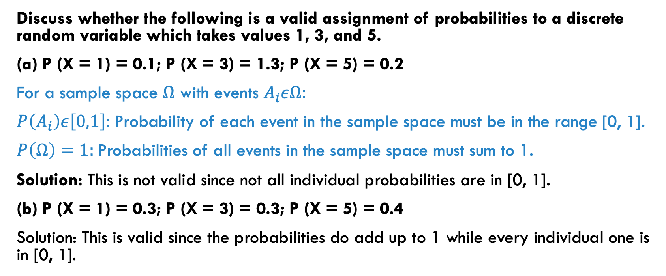
PROBLEM 1: probability measures
Discuss whether the following is a valid assignment of probabilities to a discrete random variable which takes values 1, 3, and 5.
(a) P (X = 1) = 0.1; P (X = 3) = 1.3; P (X = 5) = 0.2
For a sample space $Ω$ with events $A_{i}εΩ:$
$P\left(A_{i}\right)ε\left[0,1\right]:$Probability of each event in the sample space must be in the range [0, 1].
$P\left(Ω\right)=1:$Probabilities of all events in the sample space must sum to 1.
Solution: This is not valid since not all individual probabilities are in [0, 1].
(b) P (X = 1) = 0.3; P (X = 3) = 0.3; P (X = 5) = 0.4
Solution: This is valid since the probabilities do add up to 1 while every individual one is in [0, 1].

Slide 4
PROBLEM 2: discrete and continuous rvs
Discuss whether the following are discrete or continuous random variables.
(a) The number of points that a player scores in a basketball game.
Discrete RV: RV has a countable number of distinct values
Continuous RV: RV can reflect an infinite number of potential values within a range
Solution: This will always be an integer and hence is a discrete random variable.
(b) The number of Chemistry courses that a UCSD student has taken in their sophomore year.
Solution: This will always be an integer and hence is a discrete random variable.
(c) The distance you walk on a given day.
Solution: This is on a continuous scale. Therefore it is a continuous random variable

Slide 5
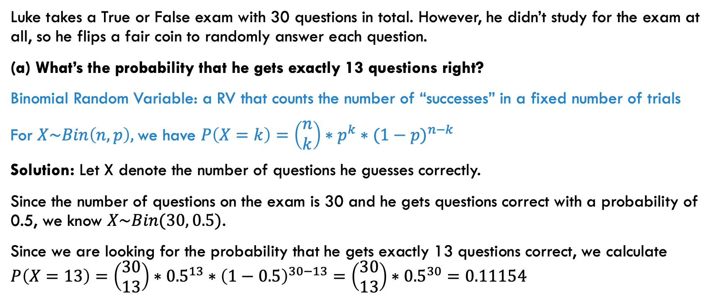
PROBLEM 3: binomial random variables
Luke takes a True or False exam with 30 questions in total. However, he didn’t study for the exam at all, so he flips a fair coin to randomly answer each question.
(a) What’s the probability that he gets exactly 13 questions right?
Binomial Random Variable: a RV that counts the number of “successes” in a fixed number of trials
For $X\sim Bin\left(n, p\right),$we have $P\left(X=k\right)=\left(\begin{matrix}n \\ k\end{matrix}\right)∗p^{k}∗{(1−p)}^{n−k}$
Solution: Let X denote the number of questions he guesses correctly.
Since the number of questions on the exam is 30 and he gets questions correct with a probability of 0.5, we know $X\sim Bin(30, 0.5)$.
Since we are looking for the probability that he gets exactly 13 questions correct, we calculate $P\left(X=13\right)=\left(\begin{matrix}30 \\ 13\end{matrix}\right)∗{0.5}^{13}∗{\left(1−0.5\right)}^{30−13}=\left(\begin{matrix}30 \\ 13\end{matrix}\right)∗{0.5}^{30}=0.11154$

Slide 6
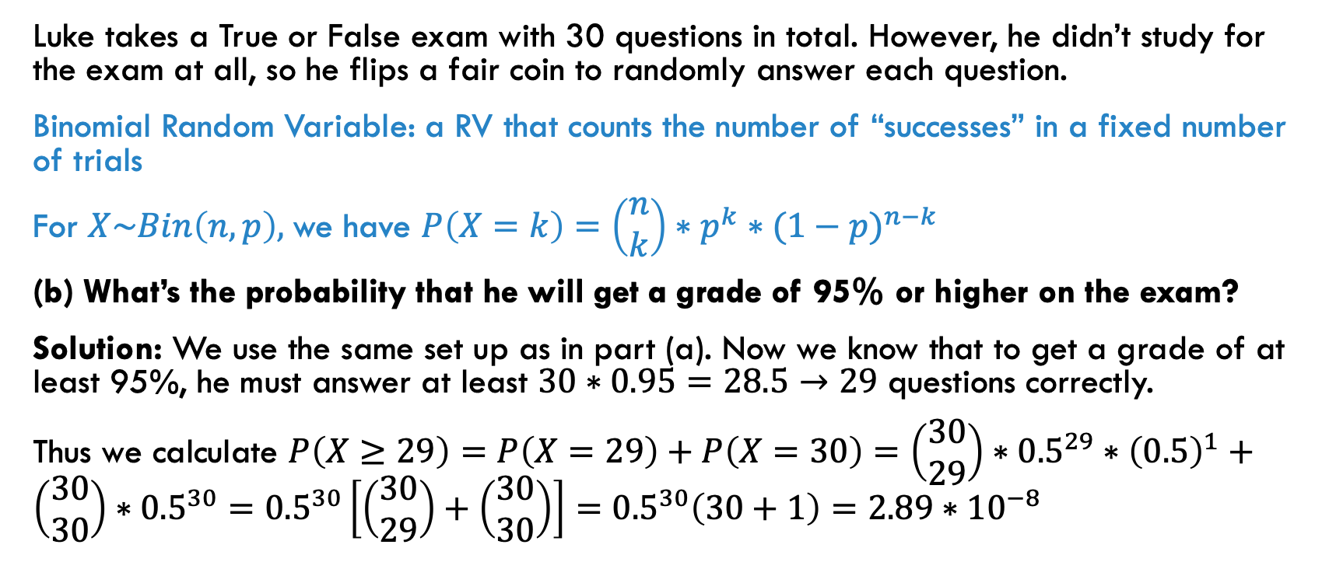
PROBLEM 3: binomial random variables
Luke takes a True or False exam with 30 questions in total. However, he didn’t study for the exam at all, so he flips a fair coin to randomly answer each question.
Binomial Random Variable: a RV that counts the number of “successes” in a fixed number of trials
For $X\sim Bin\left(n, p\right),$we have $P\left(X=k\right)=\left(\begin{matrix}n \\ k\end{matrix}\right)∗p^{k}∗{(1−p)}^{n−k}$
(b) What’s the probability that he will get a grade of 95% or higher on the exam?
Solution: We use the same set up as in part (a). Now we know that to get a grade of at least 95%, he must answer at least $30∗0.95=28.5→29$ questions correctly.
Thus we calculate $P\left(X≥29\right)=P\left(X=29\right)+P\left(X=30\right)=\left(\begin{matrix}30 \\ 29\end{matrix}\right)∗{0.5}^{29}∗{\left(0.5\right)}^{1}+\left(\begin{matrix}30 \\ 30\end{matrix}\right)∗{0.5}^{30}={0.5}^{30}\left[\left(\begin{matrix}30 \\ 29\end{matrix}\right)+\left(\begin{matrix}30 \\ 30\end{matrix}\right)\right]={0.5}^{30}\left(30+1\right)=2.89∗{10}^{−8}$

Slide 7
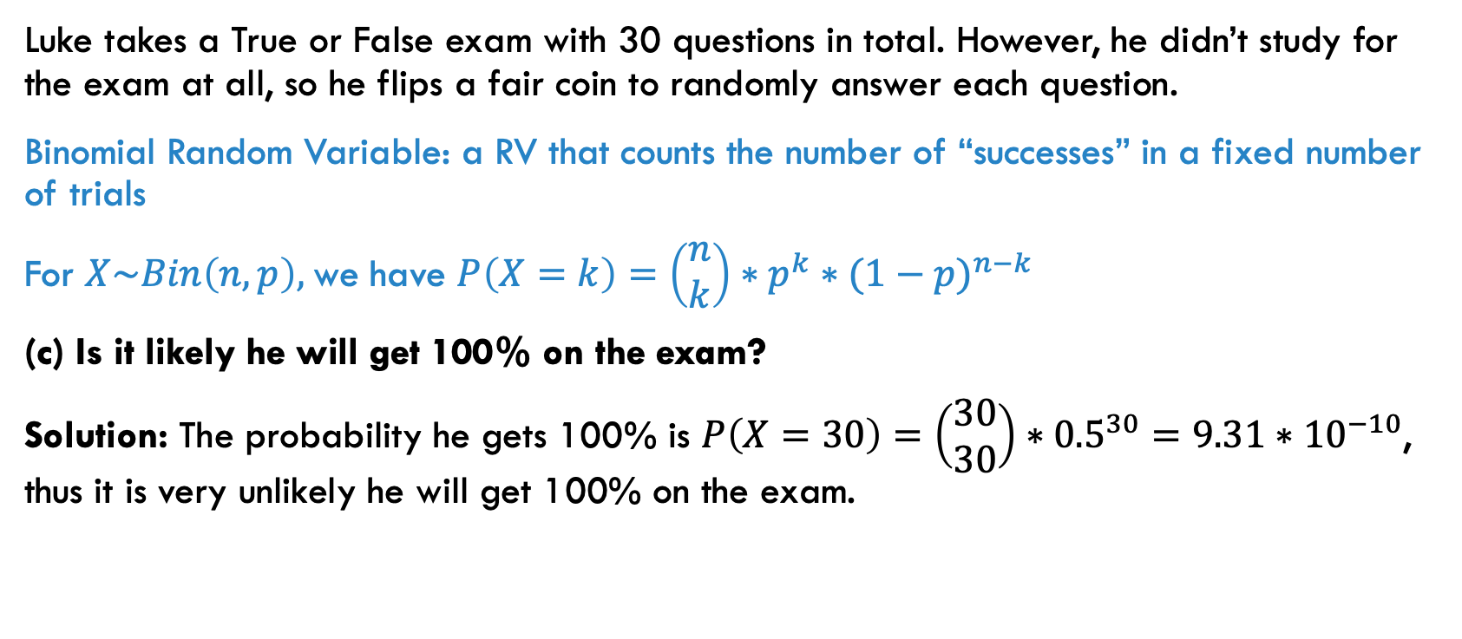
PROBLEM 3: binomial random variables
Luke takes a True or False exam with 30 questions in total. However, he didn’t study for the exam at all, so he flips a fair coin to randomly answer each question.
Binomial Random Variable: a RV that counts the number of “successes” in a fixed number of trials
For $X\sim Bin\left(n, p\right),$we have $P\left(X=k\right)=\left(\begin{matrix}n \\ k\end{matrix}\right)∗p^{k}∗{(1−p)}^{n−k}$
(c) Is it likely he will get 100% on the exam?
Solution: The probability he gets 100% is $P\left(X=30\right)=\left(\begin{matrix}30 \\ 30\end{matrix}\right)∗{0.5}^{30}=9.31∗{10}^{−10}$, thus it is very unlikely he will get 100% on the exam.

Slide 8
PROBLEM 4: properties of continuous rvs
Given that X is a continuous random variable, discuss whether the following statements are true.
(a) The expected value of X must be 1.
Solution: False. The expected value of a continuous random variable can be any real number.
(b) P(X = 4) must be positive.
Solution: False. If X is a continuous random variable, then the probability that it takes on any one particular value must be zero.

Slide 9
PROBLEM 5: symmetric distributions
Suppose Z has a standard normal distribution. We know that Z is symmetric.
If given P(Z < −a) = 0.25, what is P(Z > a)? Explain.
Solution: Since Z is symmetric and P(Z < −a) = 0.25, we know that P(Z > a) = 0.25.

Slide 10
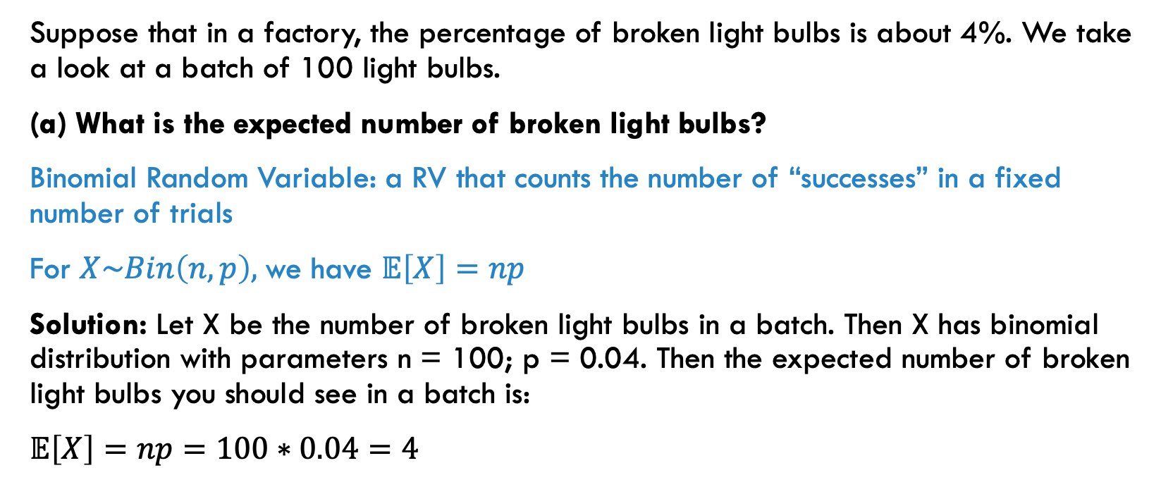
PROBLEM 6: binomial rvs
Suppose that in a factory, the percentage of broken light bulbs is about 4%. We take a look at a batch of 100 light bulbs.
(a) What is the expected number of broken light bulbs?
Binomial Random Variable: a RV that counts the number of “successes” in a fixed number of trials
For $X\sim Bin\left(n, p\right),$we have $𝔼\left[X\right]=np$
Solution: Let X be the number of broken light bulbs in a batch. Then X has binomial distribution with parameters n = 100; p = 0.04. Then the expected number of broken light bulbs you should see in a batch is:
$𝔼\left[X\right]=np=100∗0.04=4$

Slide 11
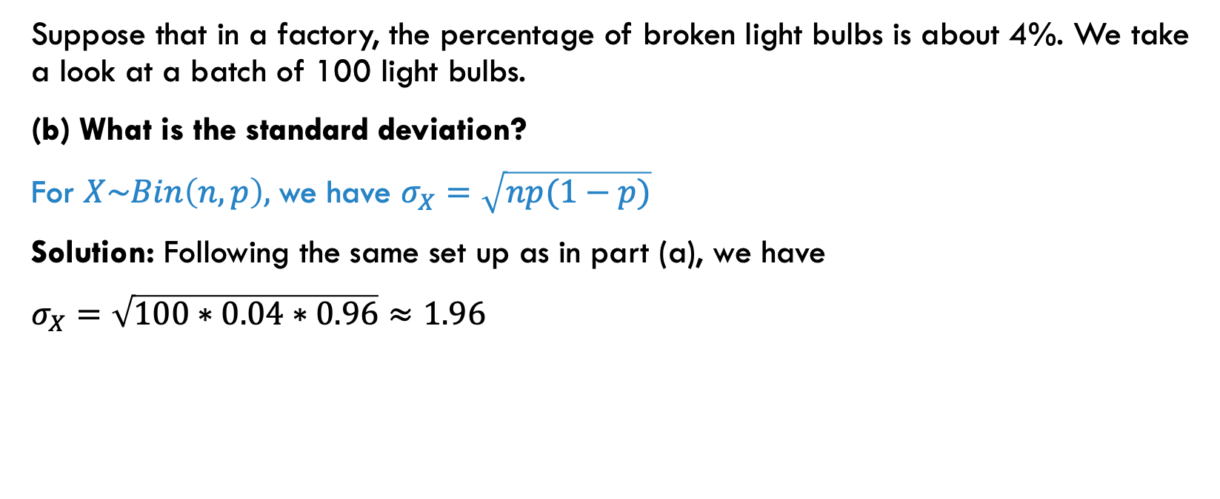
PROBLEM 6: binomial rvs
Suppose that in a factory, the percentage of broken light bulbs is about 4%. We take a look at a batch of 100 light bulbs.
(b) What is the standard deviation?
For $X\sim Bin\left(n, p\right),$we have $σ_{X}=\sqrt{np(1−p)}$
Solution: Following the same set up as in part (a), we have
$σ_{X}=\sqrt{100∗0.04∗0.96}≈1.96$

Slide 12
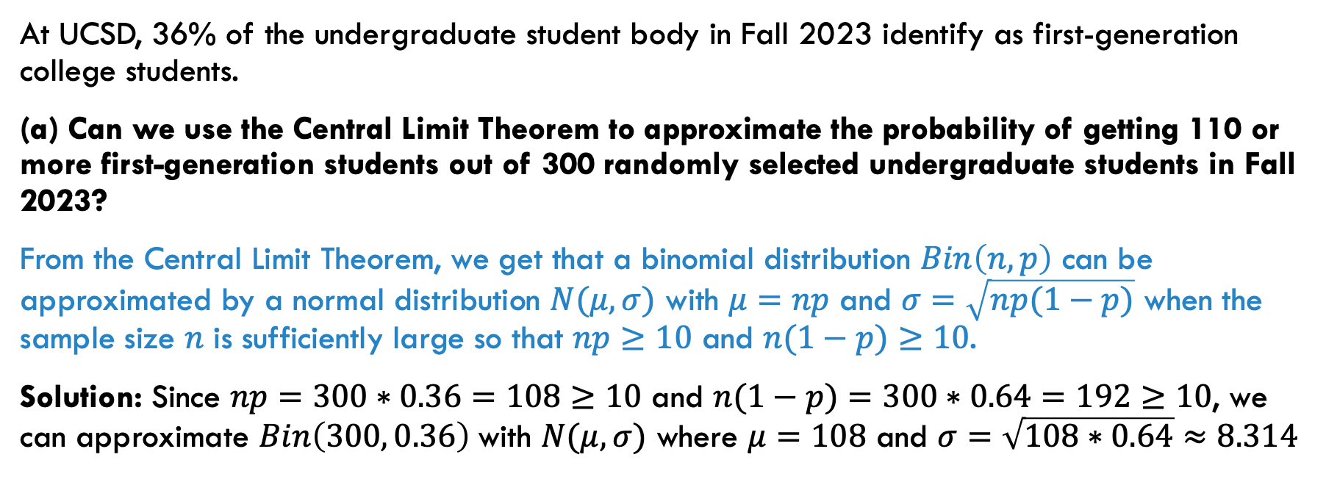
PROBLEM 7: approximating binomial dist with normal
At UCSD, 36% of the undergraduate student body in Fall 2023 identify as first-generation college students.
(a) Can we use the Central Limit Theorem to approximate the probability of getting 110 or more first-generation students out of 300 randomly selected undergraduate students in Fall 2023?
From the Central Limit Theorem, we get that a binomial distribution $Bin\left(n,p\right)$ can be approximated by a normal distribution $N(μ, σ)$ with $μ=np$ and $σ=\sqrt{np(1−p)}$ when the sample size $n$ is sufficiently large so that $np≥10$ and $n(1−p)≥10$.
Solution: Since $np=300∗0.36=108≥10$ and $n(1−p)=300∗0.64=192≥10$, we can approximate $Bin\left(300, 0.36\right)$with $N(μ, σ)$ where $μ=108$ and $σ=\sqrt{108∗0.64}≈8.314$

Slide 13
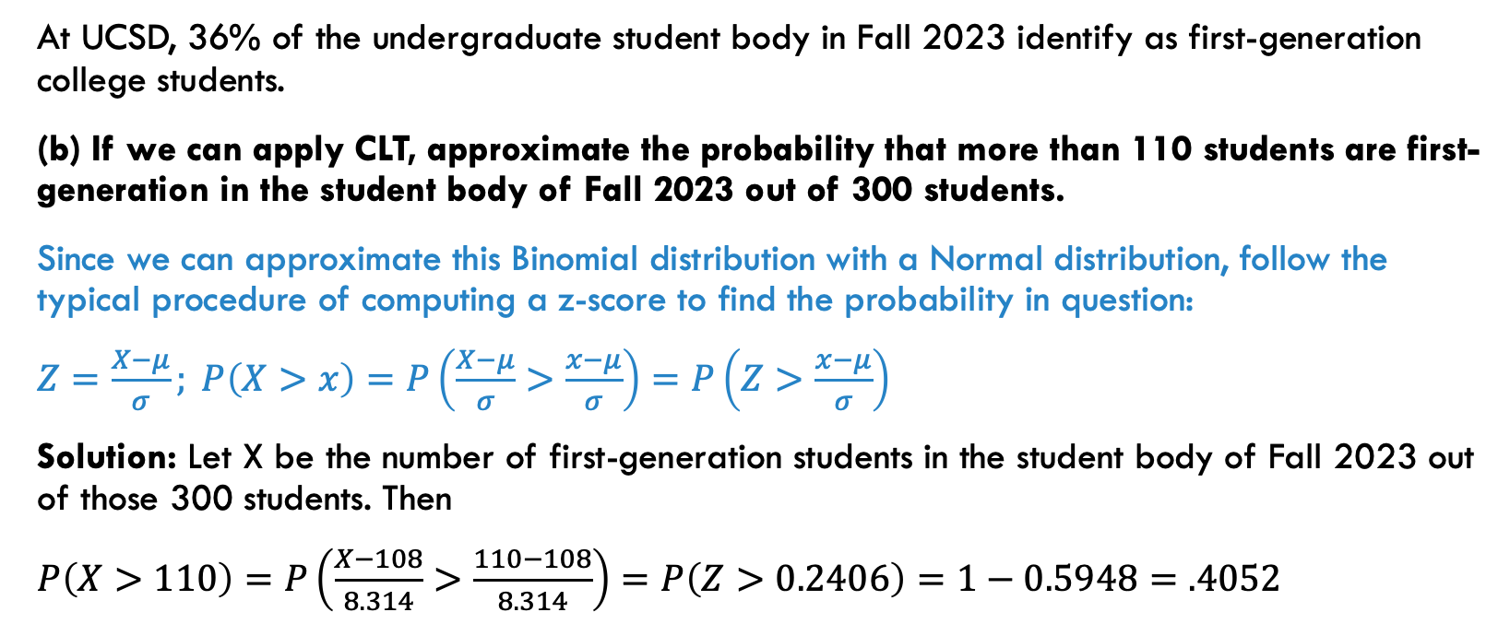
PROBLEM 7: approximating binomial dist with normal
At UCSD, 36% of the undergraduate student body in Fall 2023 identify as first-generation college students.
(b) If we can apply CLT, approximate the probability that more than 110 students are first-generation in the student body of Fall 2023 out of 300 students.
Since we can approximate this Binomial distribution with a Normal distribution, follow the typical procedure of computing a z-score to find the probability in question:
$Z=\frac{X−μ}{σ}; P\left(X>x\right)=P\left(\frac{X−μ}{σ}>\frac{x−μ}{σ}\right)=P\left(Z>\frac{x−μ}{σ}\right)$
Solution: Let X be the number of first-generation students in the student body of Fall 2023 out of those 300 students. Then
$P\left(X>110\right)=P\left(\frac{X−108}{8.314}>\frac{110−108}{8.314}\right)=P\left(Z>0.2406\right)=1−0.5948=.4052$

Slide 14
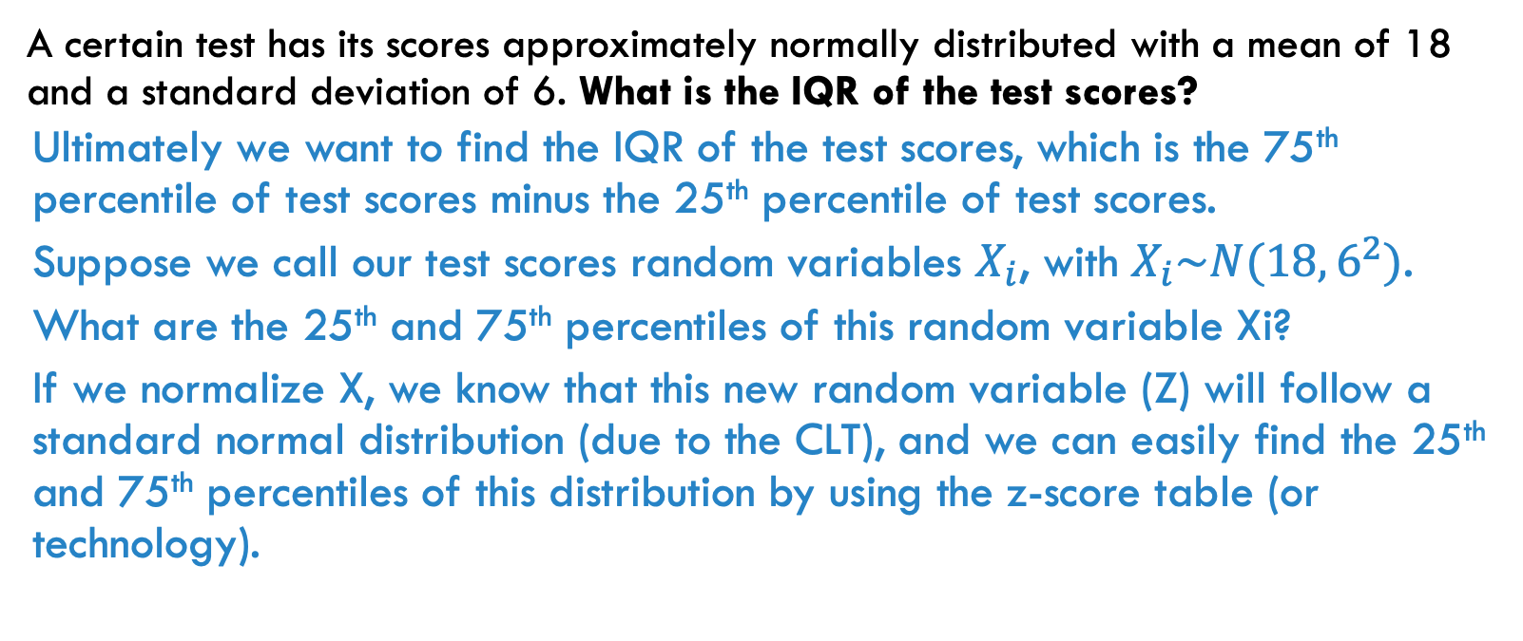
PROBLEM 8: using the standard normal dist.
A certain test has its scores approximately normally distributed with a mean of 18 and a standard deviation of 6. What is the IQR of the test scores?
Ultimately we want to find the IQR of the test scores, which is the 75th percentile of test scores minus the 25th percentile of test scores.
Suppose we call our test scores random variables $X_{i}$, with $X_{i}\sim N(18, 6^{2})$.
What are the 25th and 75th percentiles of this random variable Xi?
If we normalize X, we know that this new random variable (Z) will follow a standard normal distribution (due to the CLT), and we can easily find the 25th and 75th percentiles of this distribution by using the z-score table (or technology).

Slide 15
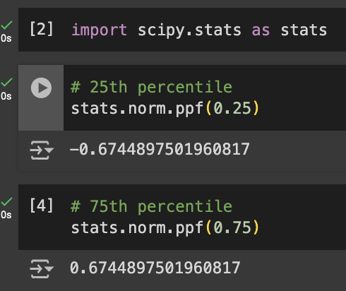
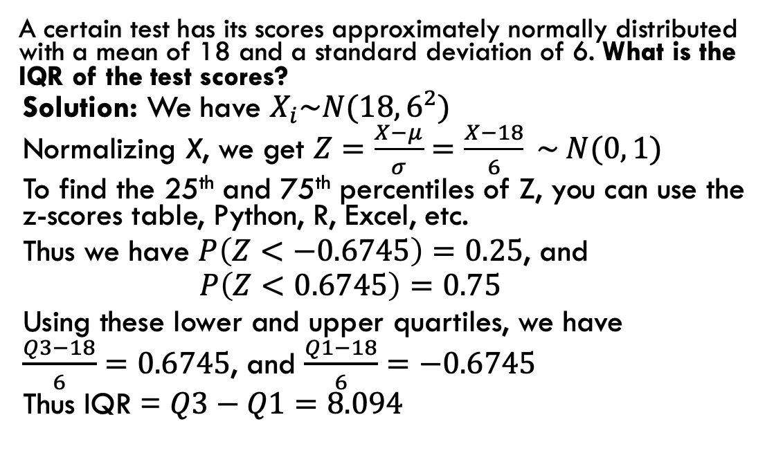
PROBLEM 8: using the standard normal dist.
A certain test has its scores approximately normally distributed with a mean of 18 and a standard deviation of 6. What is the IQR of the test scores?
Solution: We have $X_{i}\sim N(18, 6^{2})$
Normalizing X, we get $Z=\frac{X−μ}{σ}=\frac{X−18}{6} \sim N(0, 1)$
To find the 25th and 75th percentiles of Z, you can use the z-scores table, Python, R, Excel, etc.
Thus we have $P\left(Z<−0.6745\right)=0.25$, and
$P\left(Z<0.6745\right)=0.75$
Using these lower and upper quartiles, we have
$\frac{Q3−18}{6}=0.6745$, and $\frac{Q1−18}{6}=−0.6745$
Thus IQR = $Q3−Q1=8.094$
Example (Python code):

Slide 16
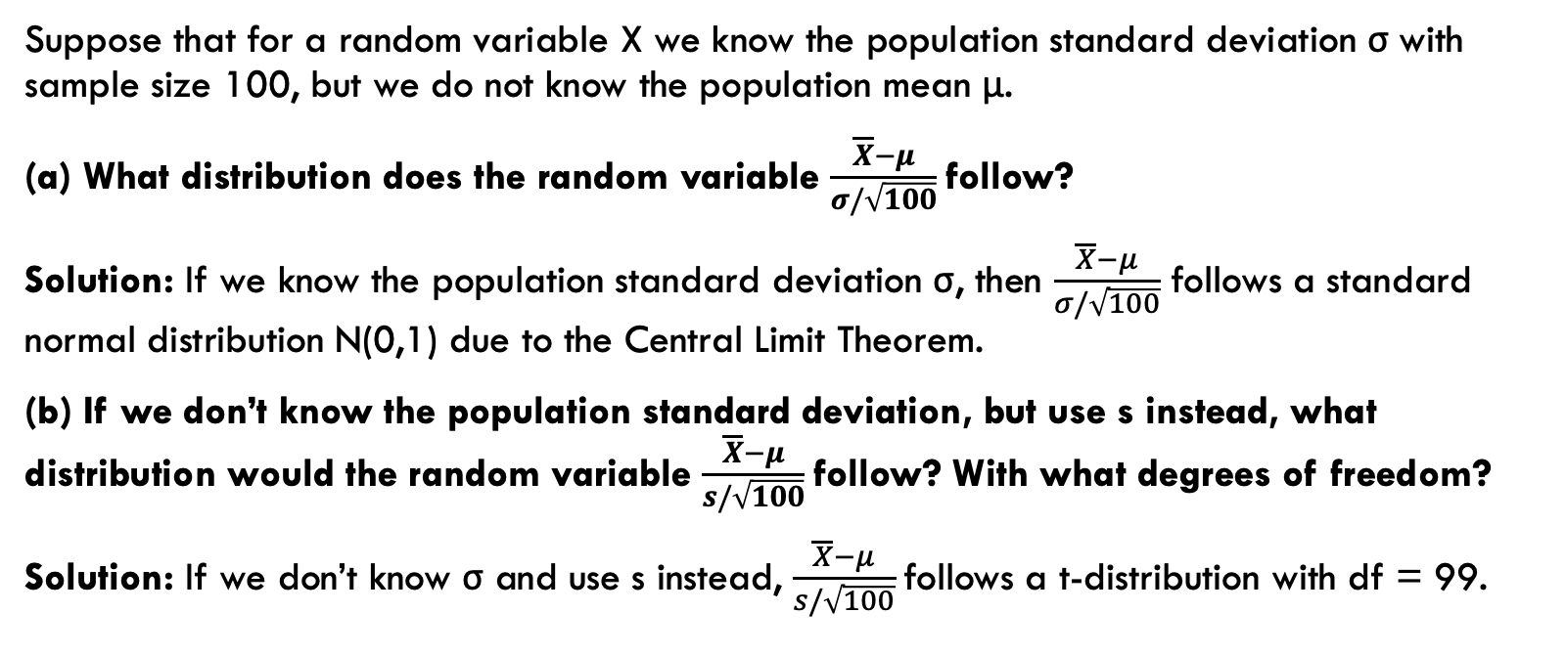
PROBLEM 9: z and t statistics
Suppose that for a random variable X we know the population standard deviation σ with sample size 100, but we do not know the population mean μ.
(a) What distribution does the random variable $\frac{\overline{X}−μ}{σ/\sqrt{100}}$ follow?
Solution: If we know the population standard deviation σ, then $\frac{\overline{X}−μ}{σ/\sqrt{100}}$ follows a standard normal distribution N(0,1) due to the Central Limit Theorem.
(b) If we don’t know the population standard deviation, but use s instead, what distribution would the random variable $\frac{\overline{X}−μ}{s/\sqrt{100}}$follow? With what degrees of freedom?
Solution: If we don’t know σ and use s instead, $\frac{\overline{X}−μ}{s/\sqrt{100}}$follows a t-distribution with df = 99.

